Slide 1


AP BIO
TOPIC 7.11:
Variations in Populations

Slide 2
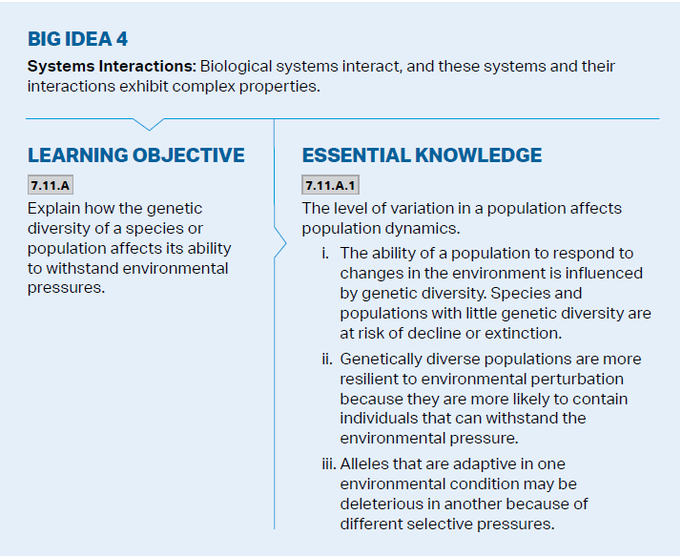
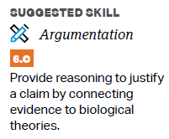
Objectives

Slide 3
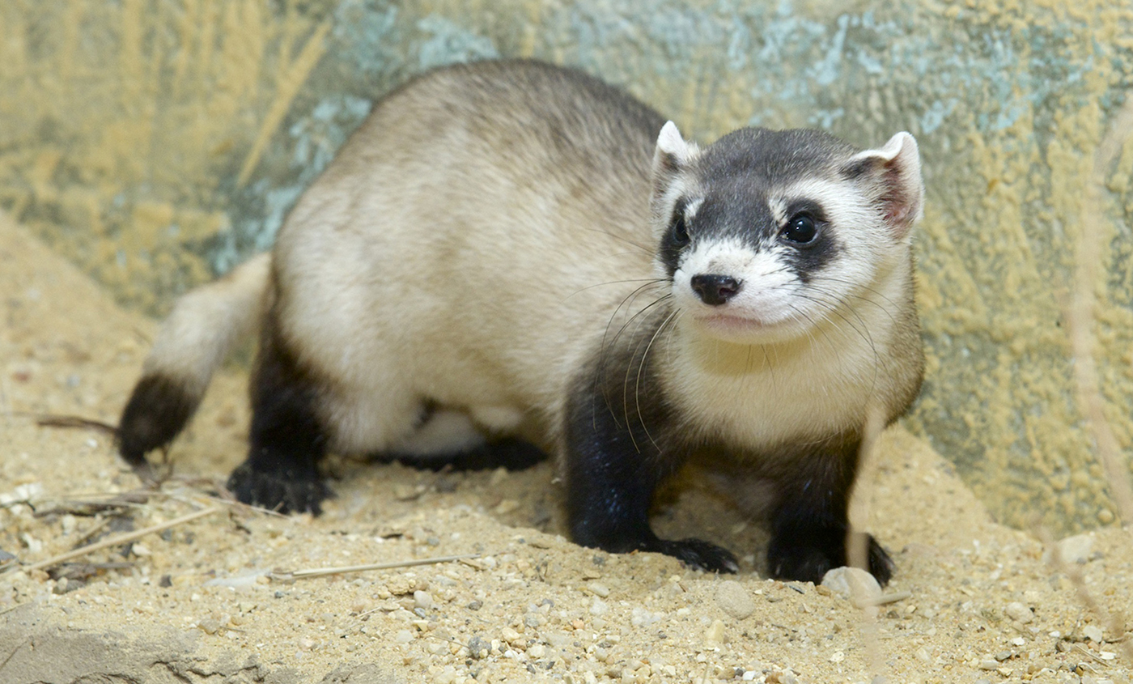
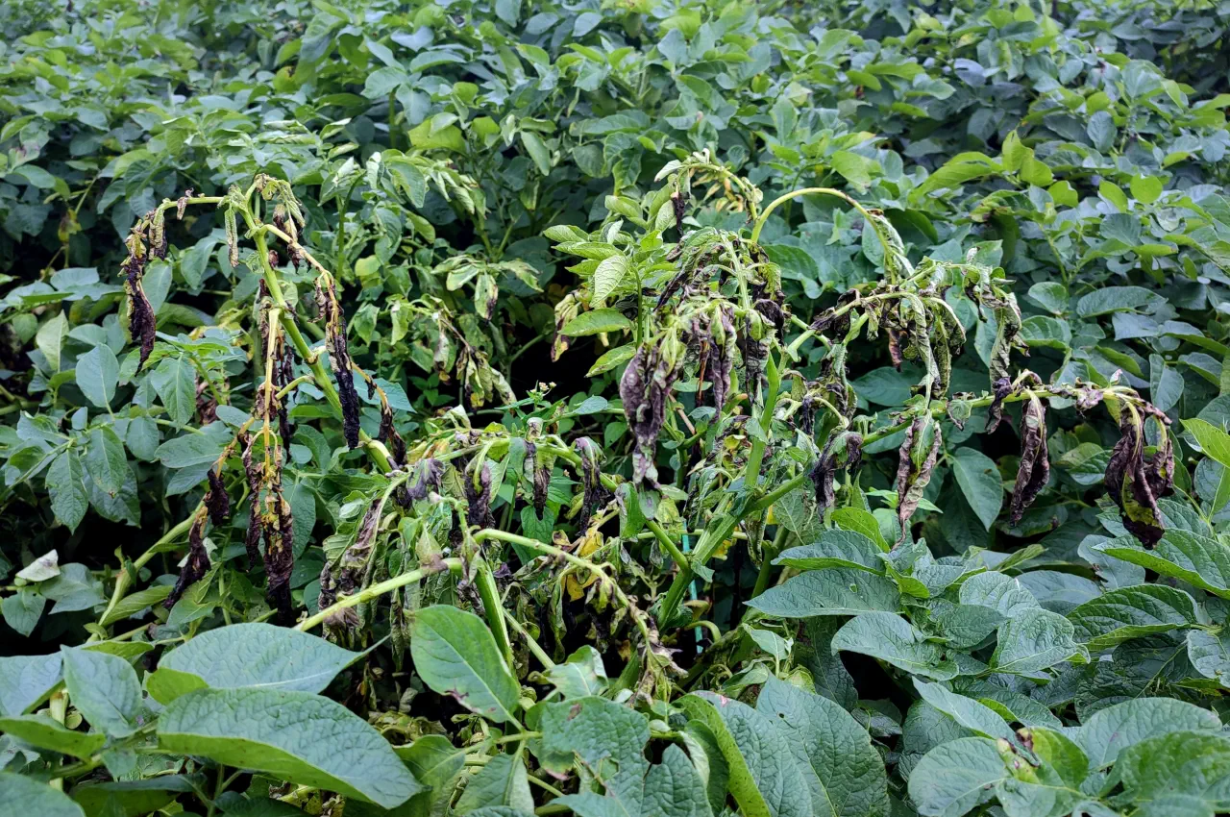
Genetic Variation and Extinction
Genetic variation is what makes natural selection possible – different genes are “selected for” in different environments
Variation can affect how much a population increases and decreases
Populations with little genetic diversity are at a risk of decline or extinction
Populations that undergo bottleneck effect have little diversity -> an environmental change can be problematic
Crops and monoculture

Slide 4
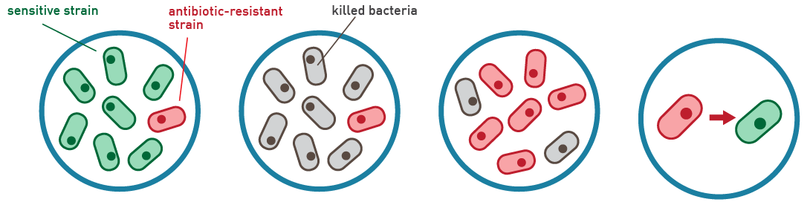
Genetic Variation and Resilience
Genetically diverse populations (and ecosystems) = more resilient to environmental change
More likely for there to be individuals that have traits which allow them to withstand/adapt to the new environment
If everyone is the same no individual is better adapted than another
Alleles that beneficial in one environment may be detrimental in another – different selective pressures
Notes:
Antibiotic resistance in bacteria – inherently able to do this due to heightened diversity within populations (mutations, horizontal gene transfer)

Slide 5
Variations in Populations Review
Benefits of genetic diversity within populations

